Slide 1
Deep Learning
U-NET Session 8
.
( content has been taken from various authors and websites)
https://arxiv.org/abs/1505.04597
Notes:
4/3/2019
1

Slide 2
Todays Agenda
U-NET
Demo
Questions.

Slide 3
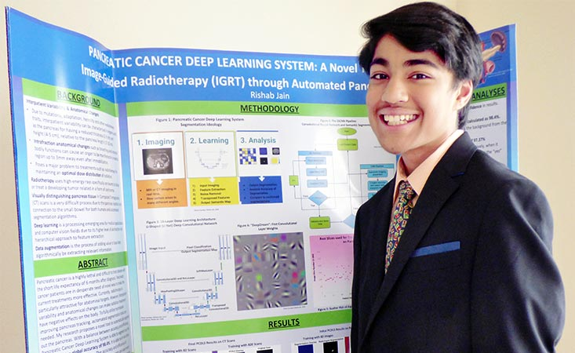
Inspiration
https://physicsworld.com/a/americas-top-young-scientist-uses-ai-to-improve-pancreatic-radiotherapy/

Slide 4
BioMedical Segmentation
Localization ( Each Pixel should be assigned a Class)
Sparse Data
Heavy use of Data Augumentation

Slide 5
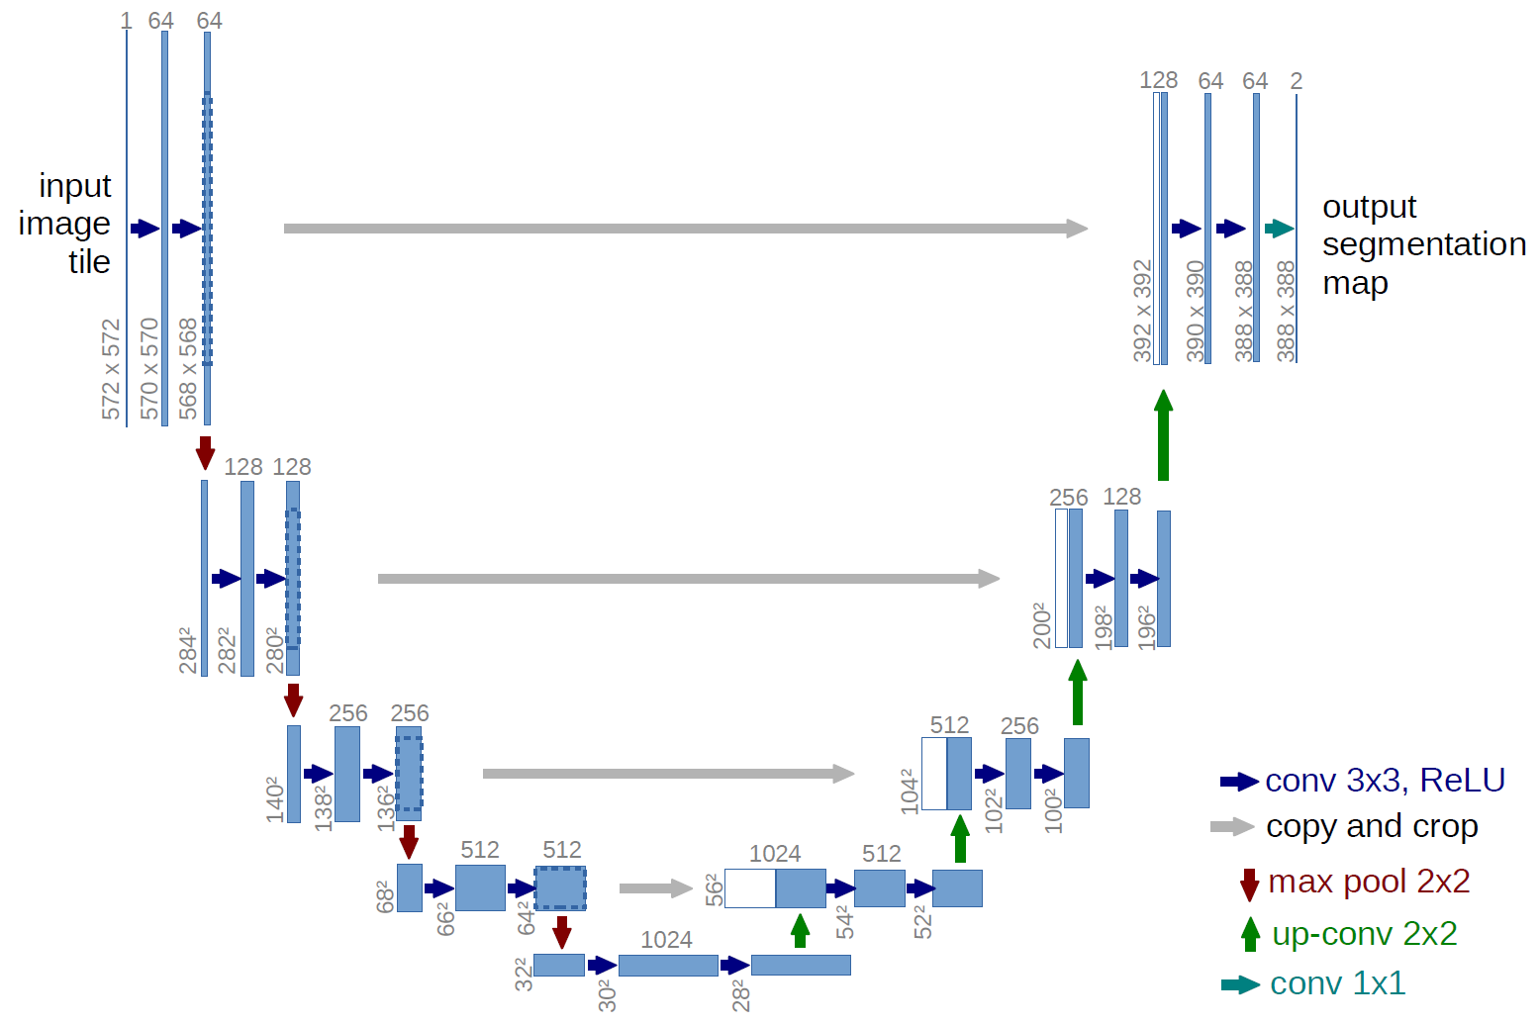
Typical U-NET Architecture

Slide 6
What is U-NET ?
U-NET is convolutional network architecture for fast and precise segmentation of images, created at the Computer Science Department of the University of Freiburg, Germany, for medical image segmentation.
U-Net is Symmetric, consisting of 3 Parts
The contracting/downsampling path
Bottleneck
The expanding/upsampling path
The Contracting path is a typical convolutional network that consists of repeated application of
3x3 Convolution Layer + activation function (with batch normalization)
3x3 Convolution Layer + activation function (with batch normalization)
2x2 Max Pooling
The bottleneck is
2 convolutional layers (with batch normalization), with dropout.
The Expansive Pathway consists of repeated application of
Deconvolution layer with stride 2
Concatenation with the corresponding cropped feature map from the contracting path
3x3 Convolution layer + activation function (with batch normalization)
3x3 Convolution layer + activation function (with batch normalization)

Slide 7
Demo
The training data is a set of 30 consecutive images (512 × 512 pixels) from a serial section Transmission Electron Microscopy (ssTEM) dataset of the Drosophila first instar larva ventral nerve cord.
Boundary detection is challenging because many boundaries look fuzzy and ambiguous. Furthermore, only boundaries between neurites should be detected, and those of intracellular organelles like mitochondria and synaptic vesicles should be ignored.

Slide 8
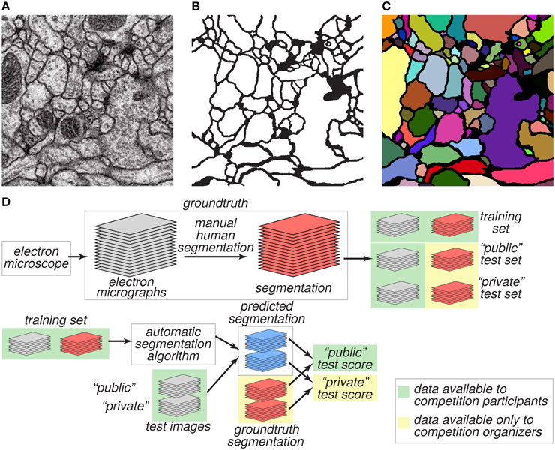
EM image of the ventral nerve cord of a larval Drosophila

Slide 9
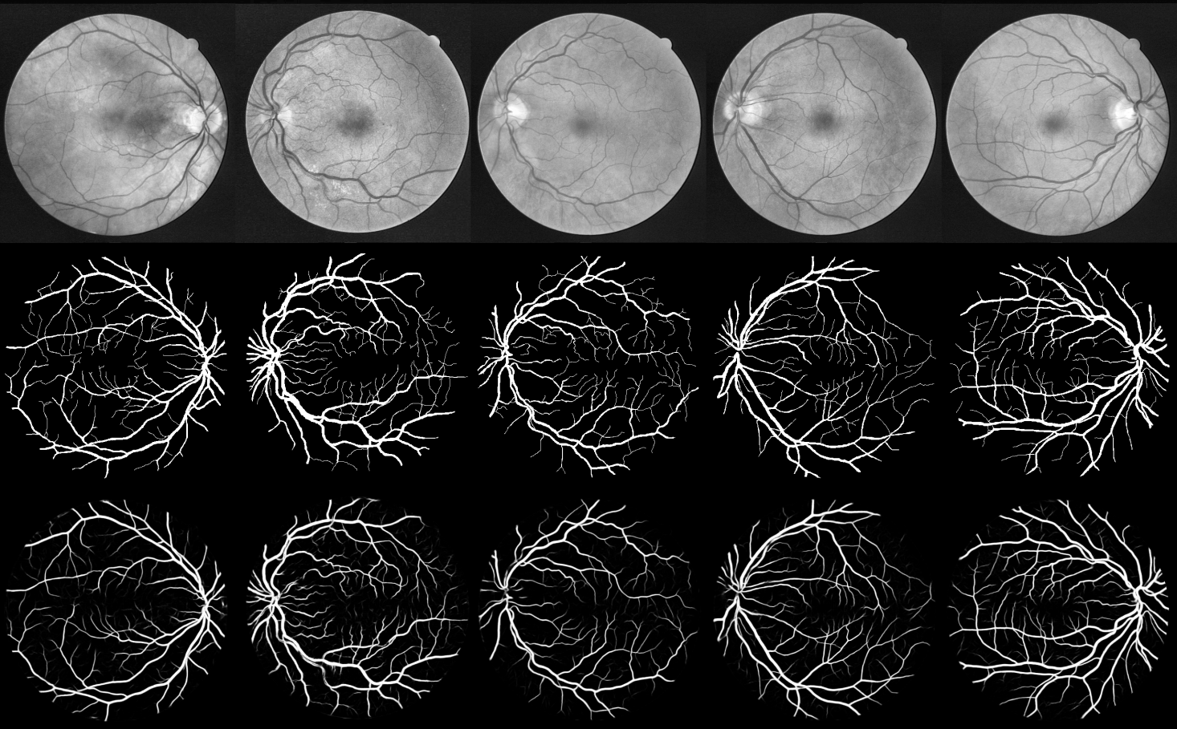
Next Session
https://github.com/orobix/retina-unet

Slide 10
References
Original Paper: https://arxiv.org/pdf/1505.04597.pdf
Segementation Papers : https://github.com/Lextal/awesome_segmentation
https://arxiv.org/pdf/1803.08691.pdf
https://www.sciencedirect.com/science/article/pii/S0169260717311823
https://medium.com/tensorflow/an-introduction-to-biomedical-image-analysis-with-tensorflow-and-dltk-2c25304e7c13
http://cs229.stanford.edu/proj2017/final-reports/5243715.pdf
https://www.frontiersin.org/articles/10.3389/fnana.2015.00142/full

Slide 11
Contact Details
Email: aliasgertalib@gmail.com
Linkedin: https://www.linkedin.com/in/aliasgertalib
GitHub
https://github.com/aliasgertalib-AI

